Slide 1
Application 1
1
1
Data is Shared via DB
2
2
Data is Shared via emails
Application 2
3
3
Data is Shared via Web Services
Application 3
4
4
Data is Shared via Messaging Systems
Application 4
5
5
Data is Shared via Files through Shared Folder
6
Data is Shared via Files through FTP Server
Application 5
6
Application 6

Slide 2
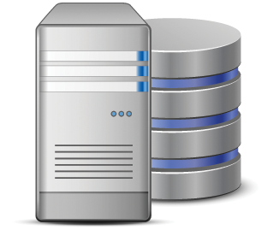
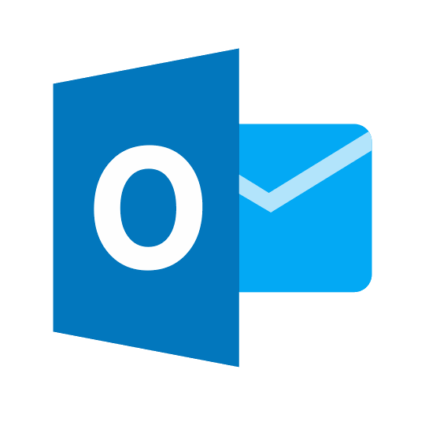
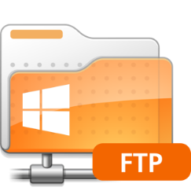
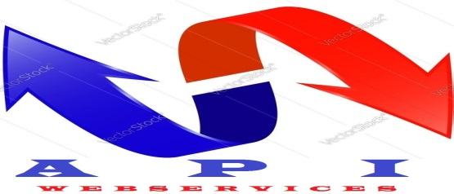


Middleware

